Slide 1
Similar Compounds Show Similar Activities- Is This True for Drug Combinations? [Additional Information]
Intern: Sarita Lee
Mentors: Raj Guha & Lu Chen

Slide 2
Diseases Treated with Drug Combinations
TB
Leprosy
Cancer
Malaria
HIV/AIDS
Etc.

Slide 3
Similarity Property Principle

Slide 4
http://pubs.acs.org/doi/full/10.1021/ci7004093

Slide 5
Methods to Measure Synergy

Slide 6
Highest Single Agent (HSA)
Taking the highest of the two numbers
Too simple for this application

Slide 7
Bliss Independence Model
Testing for independence:

Slide 8
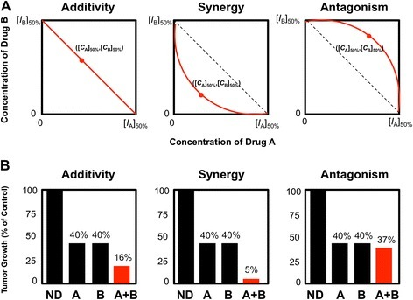
Loewe Additivity Model
Based on dose response curve
Not reliable curve since only 6 or 10 points of data
https://openi.nlm.nih.gov/detailedresult.php?img=PMC4348553_13321_2015_55_Fig2_HTML&req=4

Slide 9
Methods to Measure Dissimilarity

Slide 10
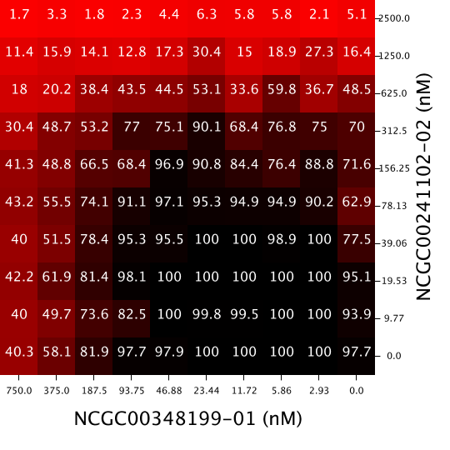
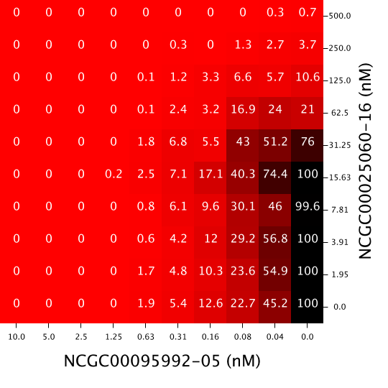
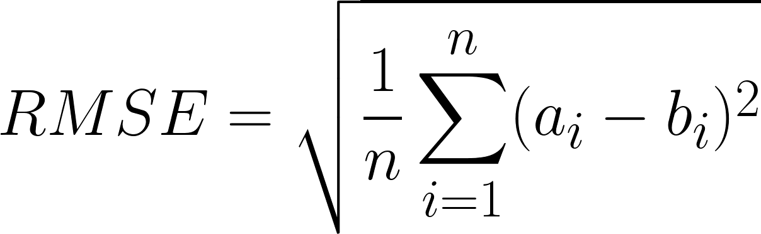
RMSE
Drug Combo A
Drug Combo B
Pairwise comparison:

Slide 11
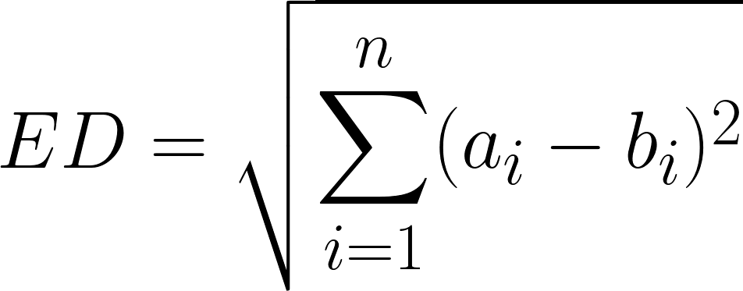
Euclidean
Drug Combo A
Drug Combo B
Pairwise comparison:

Slide 12
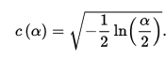
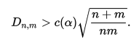
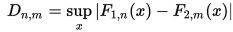
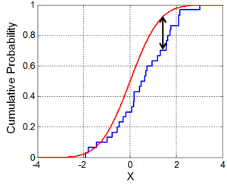
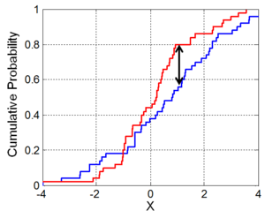
Two – Sample KS Test
Null hypothesis: there is no difference between the two datasets
Accepted or rejected
Two Sample- means neither of the distributions are taken as the expected

Slide 13
Syrjala Test
Null hypothesis: there is no difference between the two datasets
Simulation
Sensitive to spatial distribution
Insensitive to differences in amounts between the two datasets
Accept or reject the null- based on p value
http://www.jstor.org/stable/2265656

Slide 14
Computing Comparisons for All Drugs in an Assay
Matrix @ NCATS: https://matrix.ncats.nih.gov/

Slide 15
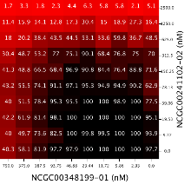
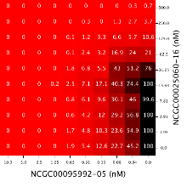
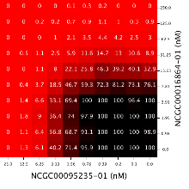
Dissimilarity Metrics- Response Matrices in an Assay
Step 1: Compare one drug combination
to one other drug combination
Step 2: Compare one drug combination
to all other drug combinations
Step 3: Compare all drug combinations
to all other drug combinations

Slide 16
Dissimilarity of Compounds- Steps

Slide 17
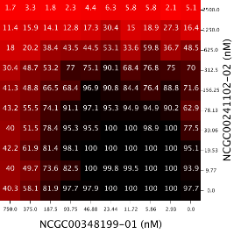
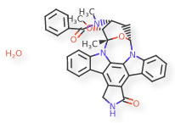

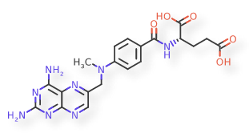
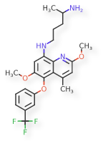
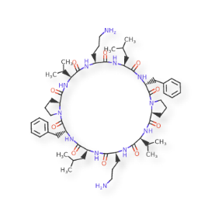
Structure Correlated With Response- Dissimilarity of Compounds
Step 1. Compare one drug combination to another drug combination
Compare corresponding x agents
Compare corresponding y agents
Average those values
Step 2: Compare one drug combination to all other drug combinations
Step 3: Compare all drug combinations to all other drug combinations
x agents’ dissimilarity
y agents’ difference
Average dissimilarity

Slide 18
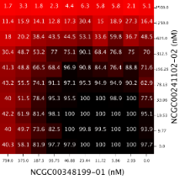
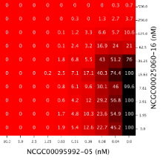
Dose Response Correlated With Response- Dissimilarity of Dose Responses
Step 1. Compare one dose response to another dose response
Compare corresponding x agents
Compare corresponding y agents
Average those values
Step 2: Compare one dose response to all other dose responses
Step 3: Compare all dose responses to all other dose responses
x dose responses’ dissimilarity
y dose responses’ difference
Average dissimilarity

Slide 19
Three Malaria Assays

Slide 20
RMSE- Three Assays

Slide 21
Syrjala- Three Assays

Slide 22
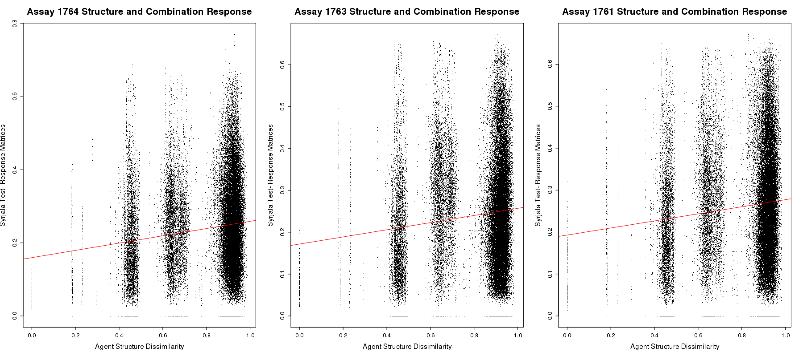
Question 2: Structure Correlated With Combination Response- Three Malaria Strains: HB3 (AID 1764), dD2 (AID 1763), 3D7 (AID 1764)

Slide 23
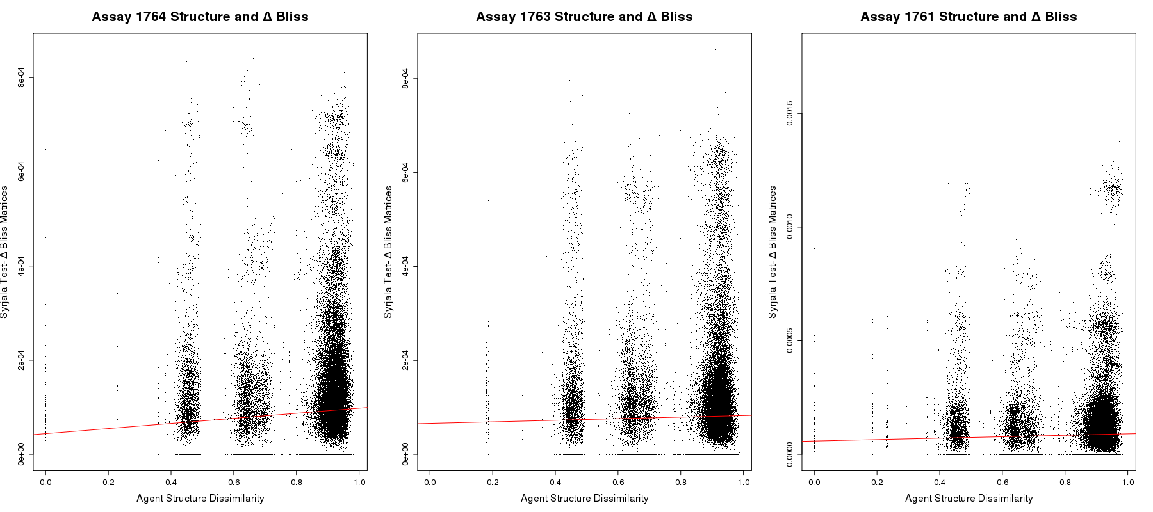
Question 2: Structure Correlated With Synergy- Three Malaria Strains: HB3 (AID 1764), dD2 (AID 1763), 3D7 (AID 1764)

Slide 24
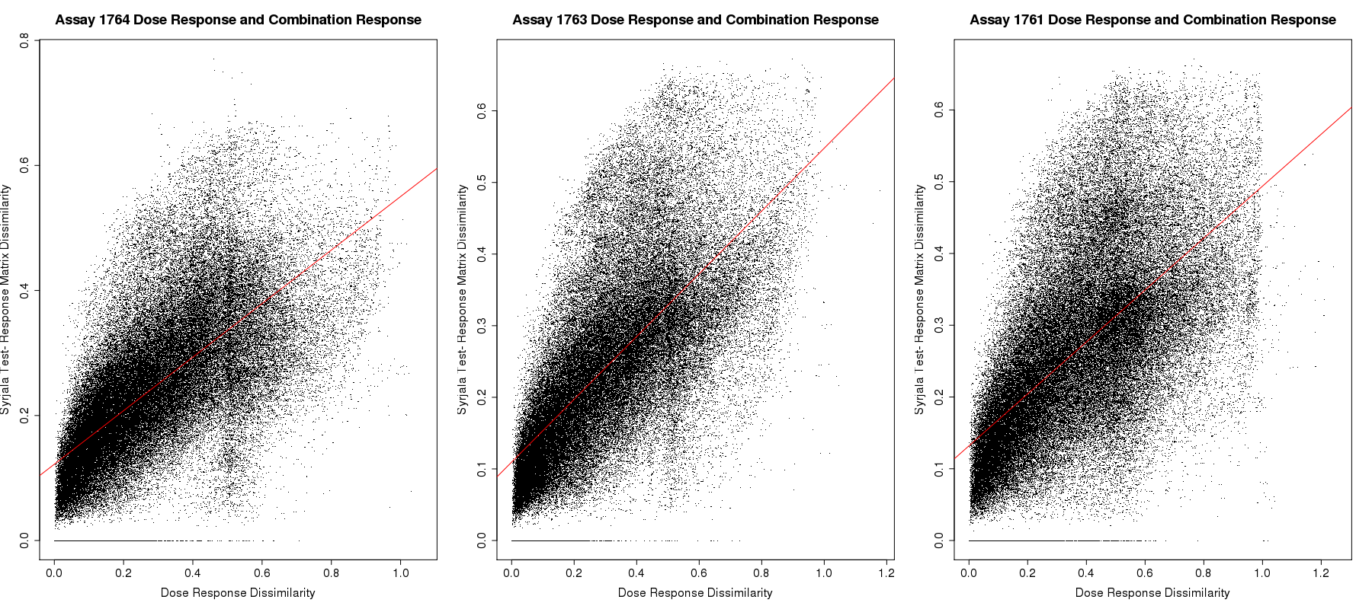
Question 3: Dose Response Correlated With Combination Response- Three Malaria Strains: HB3 (AID 1764), dD2 (AID 1763), 3D7 (AID 1764)

Slide 25
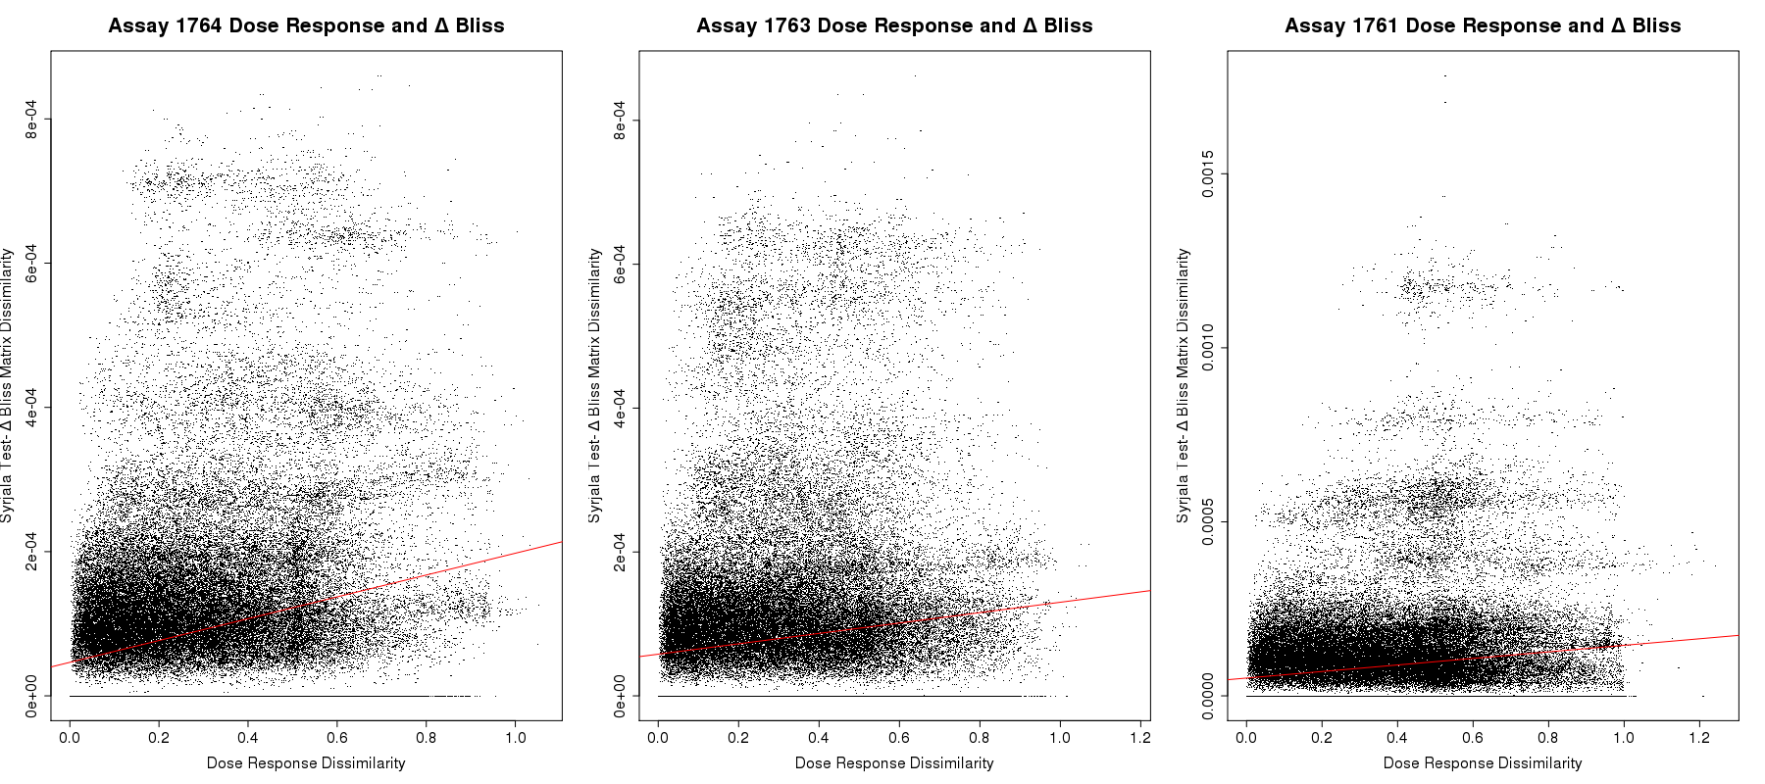
Question 3: Dose Response Correlated With Synergy- Three Malaria Strains: HB3 (AID 1764), dD2 (AID 1763), 3D7 (AID 1764)

Slide 26
Activity Correlated with Synergy- Response Surfaces vs Delta Bliss Surfaces

Slide 27
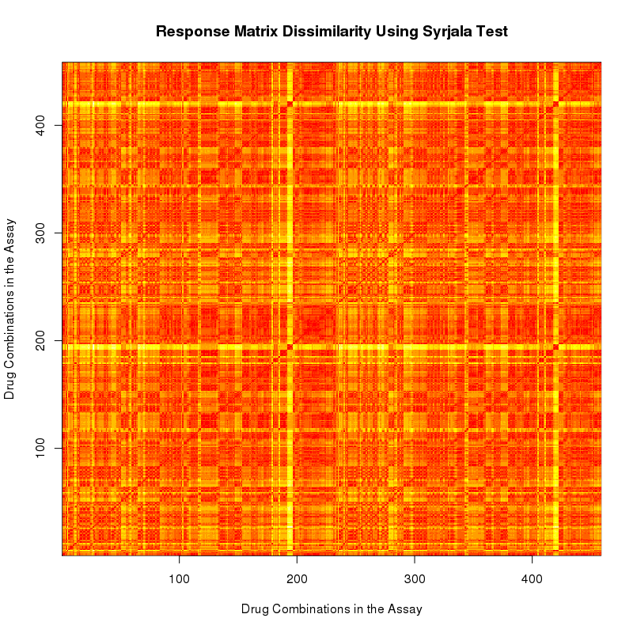
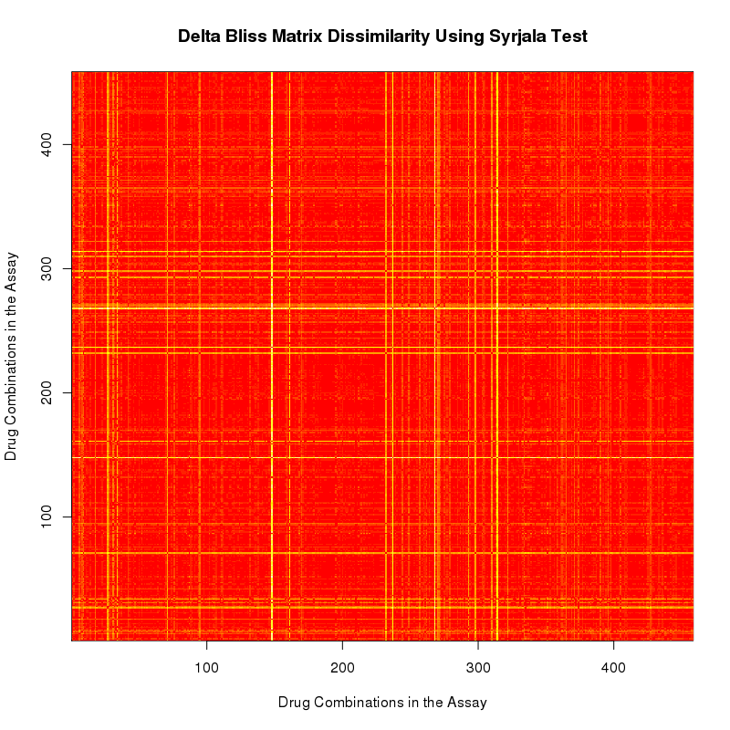
Question 2: Activity Correlated With Synergy- Malaria Assay 1764
Response Matrix Dissimilarity-
Syrjala Test
Delta Bliss (Synergy) Matrix Dissimilarity-
Syrjala Test
Do these correlate?

Slide 28
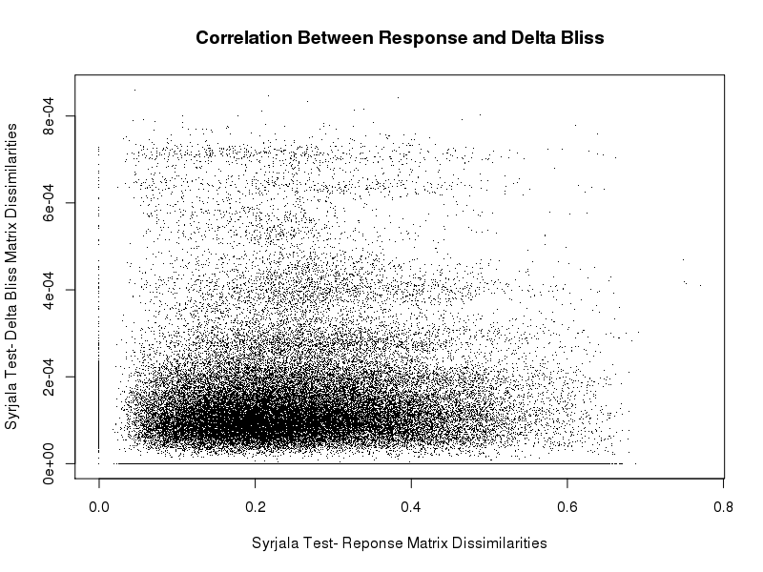
Question 2: Activity Correlated With Synergy- Response Surfaces vs Delta Bliss Surfaces

Slide 29
Three Malaria Assays

Slide 30
Dose Response- Lin’s CCC

Slide 31
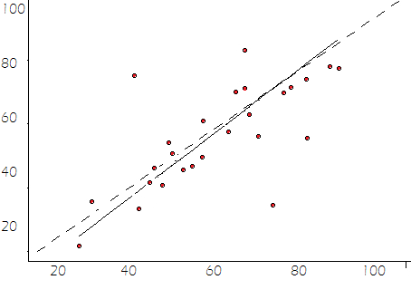
Lin’s CCC- concordance correlation coefficient
Compares one set to another- how well a set or data compares to standard measurement/ test
Ranges from -1 to +1
0 = no correlation
-/+ 1 = perfect correlation (negative correlation, not shown in our data because this would indicate an inverse relationship and all of dose responses started around 100 and decreased)
https://www.jstor.org/stable/2532051?seq=1#page_scan_tab_contents

Slide 32
Discordant Pairs

Slide 33
Three Malaria Assays- Discordant Pairs

Slide 34
Assay 6410

Slide 35
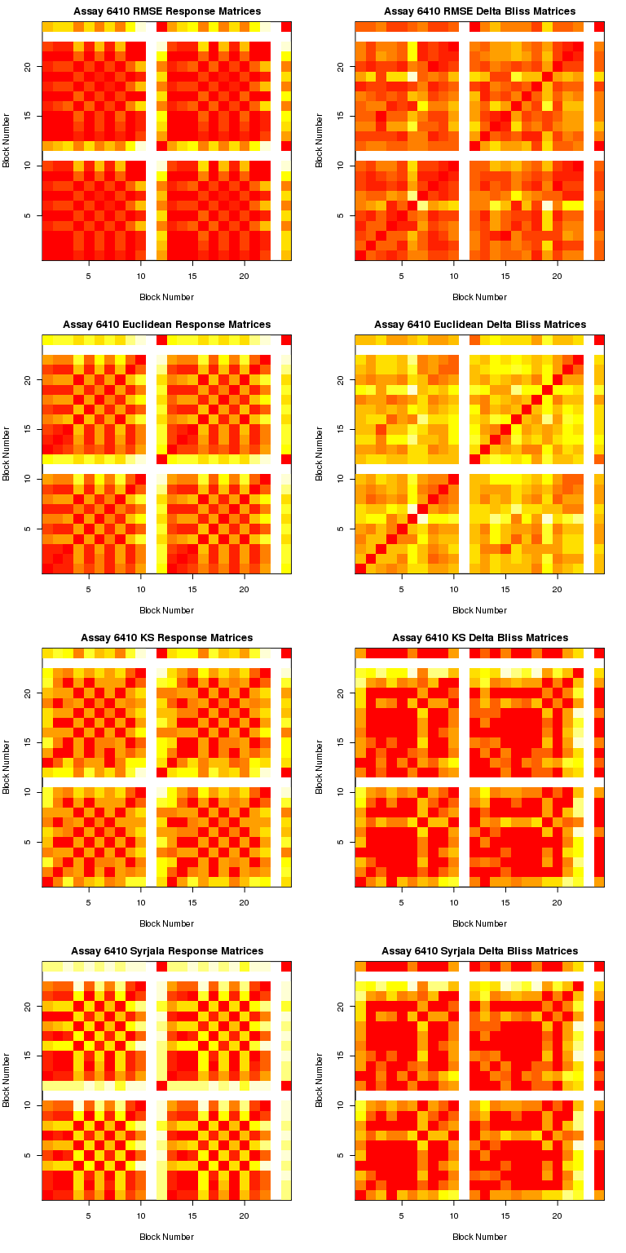
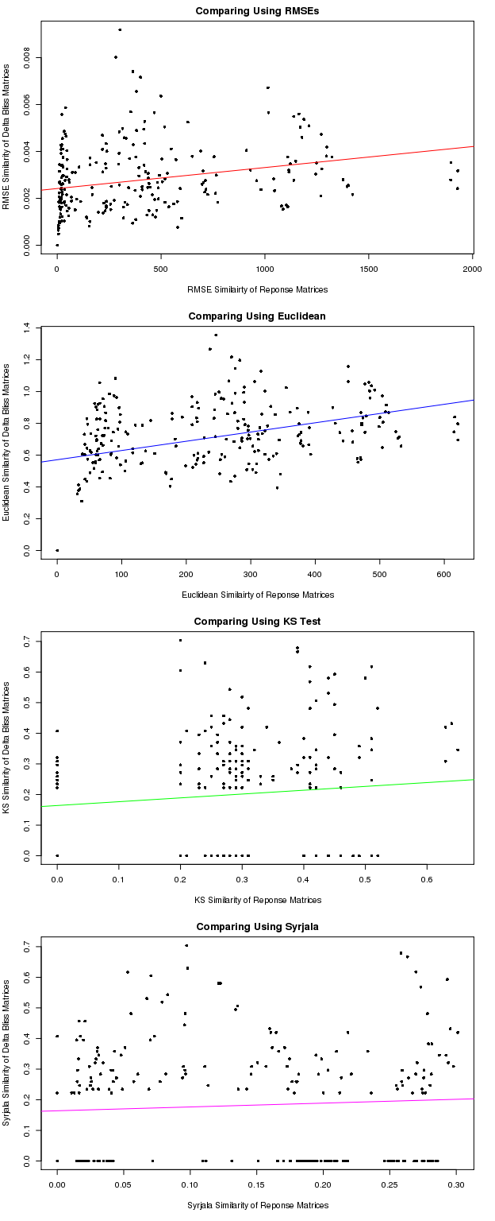
Assay 6410

Slide 38
Assay 265

Slide 39
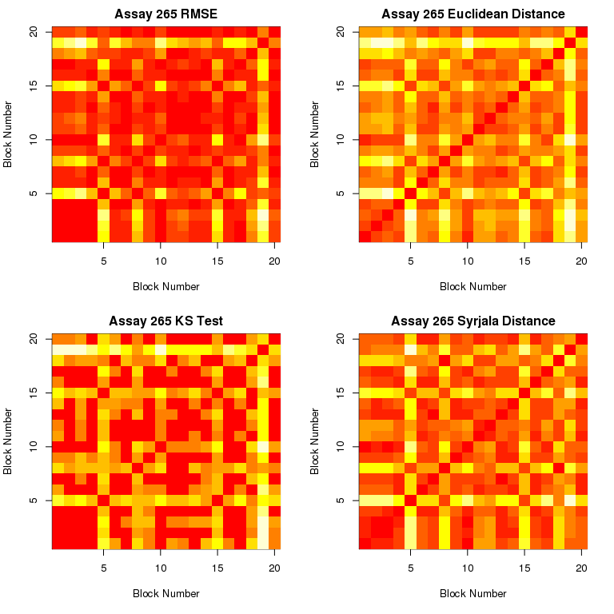
Dissimilarity Metrics

Slide 40
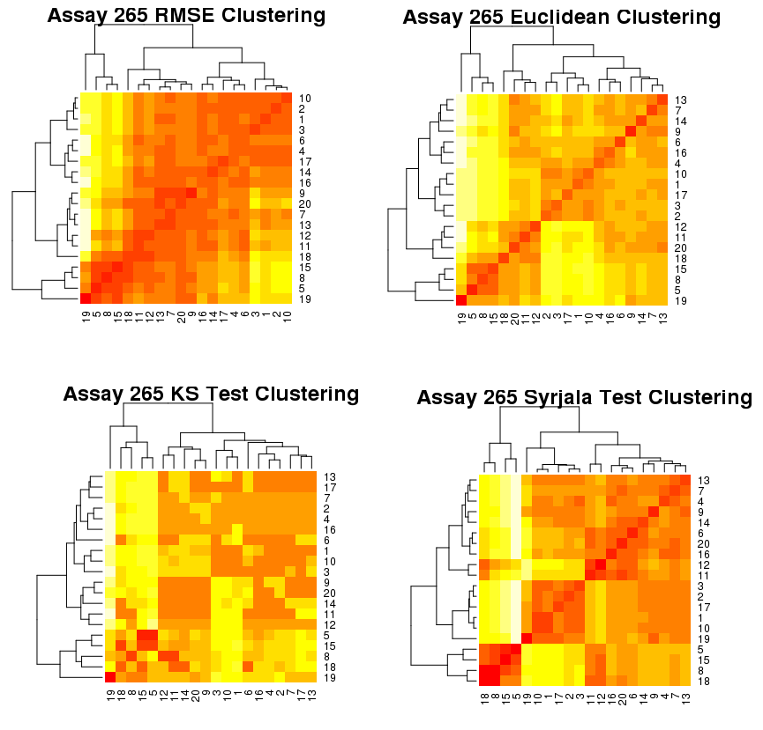
Clustering

